Slide 1

Branch predictors GEM5 simulation
CS6304 Project 2
JXP220032, Jayanth Avinash Potnuru
Yxs170430 , Yixin Sun

Slide 2
What & why are ‘Branch Predictors’
Modern processors often have deeper pipelines (more than basic 5 stages)
Branch predictors are used to predict the direction of a branch (taken / not take) while executing the instruction stream in a processor core.
Without branch predictors, taken/not taken is only known after EX stage (IF > ID > EX > MEM > WB), hence if the next instructions enters the pipeline and branch is taken i.e all the instructions that entered after Branch Instructions needs to flushed out. This incurs huge penalty on performance and efficiency of processor. Deeper the pipeline , higher the penalty
Hence a strong necessity of Branch predictors to determine the direction during the IF stage itself.
An efficient branch predictor is one of the important design parameter in CPU micro architecture. Usually plays an important role in CPU frontend. It helps in better instruction cache prefetching, there by reducing the necessity for large L1 Instruction caches, reducing cost of chip production.

Slide 3

Some engineering facts about branch predictors in modern processors..
Tournament predictors are commonly used in modern CPUs, including the Intel Core i7, i9, and Xeon families, as well as the AMD Ryzen and EPYC families
The ARM Cortex-A3x processors use a combination of branch predictors, including a 2-bit local predictor, a G-share predictor, and a tournament predictor (usually GShare > GSelect)
Intel Core i7-10700K processor has a pipeline depth of 14 stages and Core i9-11900K has 20 stages while ARM cortex X3 has 15 stages.
On an average there is BRANCH instruction executed for every 8 instructions in general purpose computing. This implies for CPUs to take advantage of large ROBs ( re-order buffer) , the branch predictors must be extremely accurate to minimize ROBs flushes.
Refereces
https://software.intel.com/content/www/us/en/develop/articles/intel-sdm.html
https://developer.arm.com/documentation/ddi0438/latest

Slide 4
Some Branch predictor types
Static
Always taken
Dynamic
2-Bit Local
BiModeBP
Tournament
2-Level adaptive
Neural

Slide 5
Our work
We analyze following branch predictors using GEM5 simulator
2–Bit local Predictor (Local)
BiModeBP Predictor (has Local & Global history table)
Tournament Predictor ( 2 sub predictors)

Slide 6
Branch Predictor | Description | Pros | Cons | Type (Local/Global)
2-bit local | A simple local predictor that uses a two-bit counter to track the outcome of each branch. | Simple and easy to implement. | Not suitable for highly complex programs. | Local
Bimodal | A global predictor that uses a two-bit counter to predict the outcome of each branch. | Suitable for a wide range of programs. | Can be prone to mispredictions when faced with highly complex programs. | Global
Tournament | A combination of local and global predictors that selects the most accurate predictor based on their performance history. | Can provide high accuracy for a wide range of programs. | Can be more complex and costly to implement. | Hybrid (Local and Global)
BiModeBP | A branch predictor in that uses a bimodal predictor with local and global history tables. | Provides flexibility to optimize predictor accuracy for different programs. | Can require more tuning and optimization than other predictors. | Hybrid (Local and Global)

Slide 7
Experimentation process..
We made few changes to GEM5 source code for the simulations to get stats.txt:system.cpu.branchPred.BTBMissPct in the output stats
We used python script simulationRunner.py to spawn jobs on the provided server.
The UTD server provided is a 4 core machine and can handle 4-8 processeses efficiently . Using concurrent executor pools of size 8 , we were able to run all the simulations for 195 configurations 8 at a time each running for about 20 mins.
Overall simulation took a day for initial testing and final execution
Used openpyxl python library to extract all the stats from stats directory

Slide 8
Executing the simulations..
Scripts are available at https://github.com/PJAvinash/GEM5.git
SimulationRunner.py is the script for triggering the jobs. Takes a config filename as parameter and number of instructions to simulate.
Senew.py is the config for GEM5 found the same directory.
This git repo is cloned at /home/010/j/jx/jxp220032/CS6304P2/gem5/configs/GEM5
Then: git pull https://github.com/PJAvinash/GEM5.git
Then: python simulationRunner.py senew.py 500000000
This executes simulations for all the valid configurations from the combinations
Branch predictors : (Local , BiModal, Tournament)
Local size (1024,2048,4096), Global size (1024,2048,4096), Choice size (1024,2048,4096),
benchmarks =('401.bzip2','429.mcf','456.hmmer','458.sjeng','470.lbm’)

Slide 9
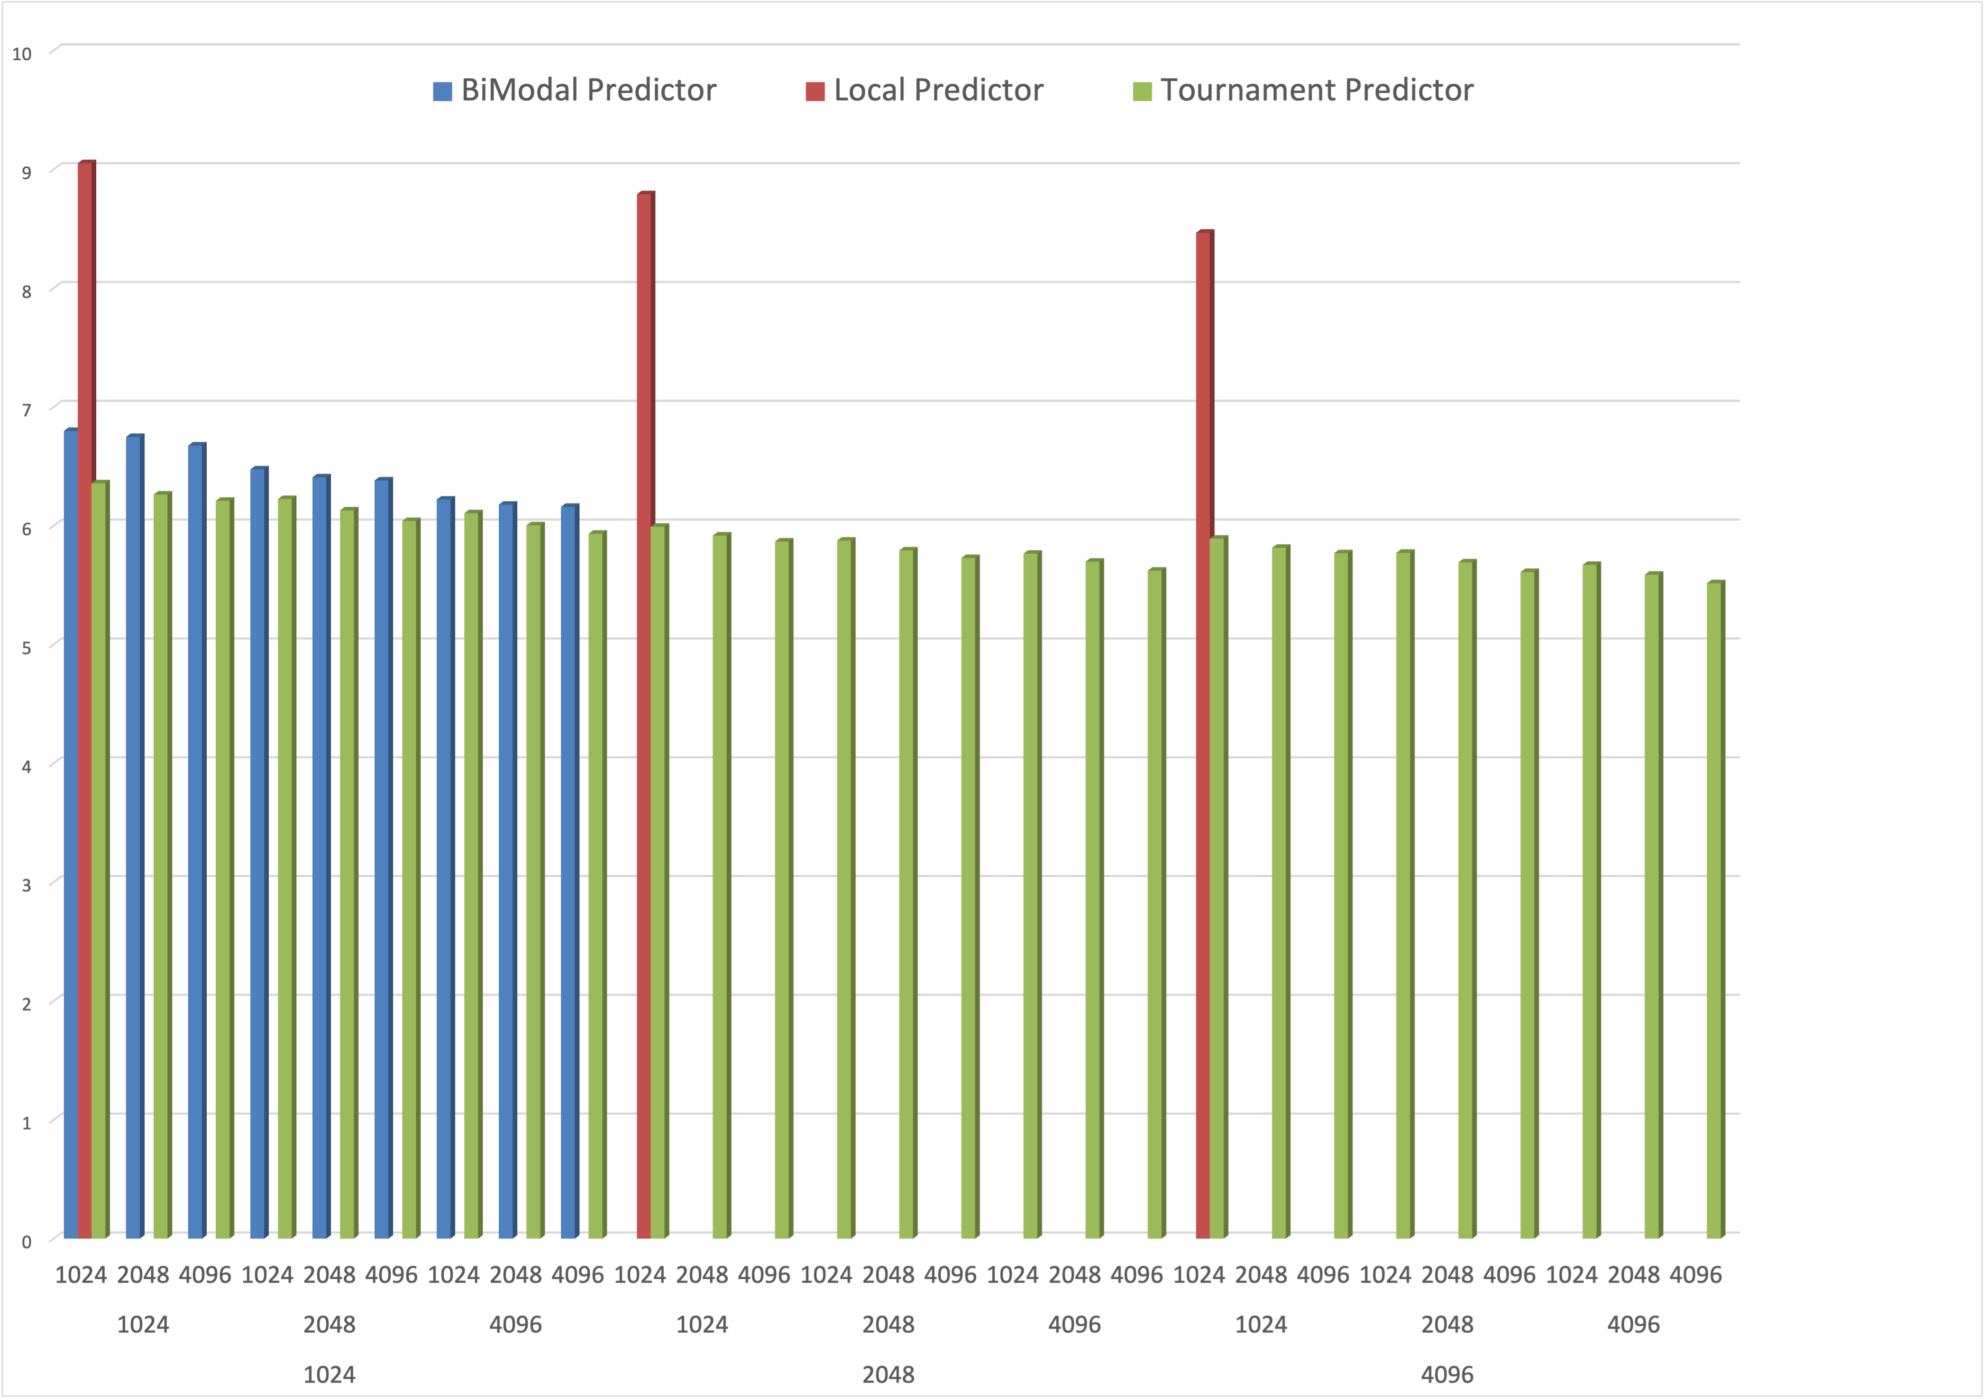
Results
The plot shows average misprediction% for each of the branch predictor ( for Choose size , Global Size , Local size on x axis from top to bottom)
Tournament Predictor performs the best in this and BiModal is good, Local is the least accurate
Larger table sizes account for better accuracy.

Slide 10
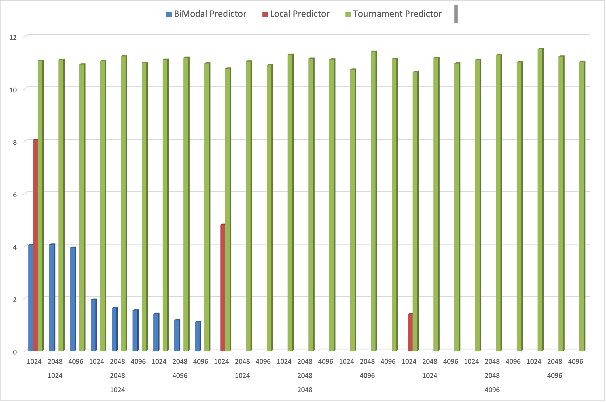
Average BTB Miss%
But tournament has highest amount of BTB misses and Global has the least amount of BTB misses.(choose,global,local in order on x axis)

Slide 11
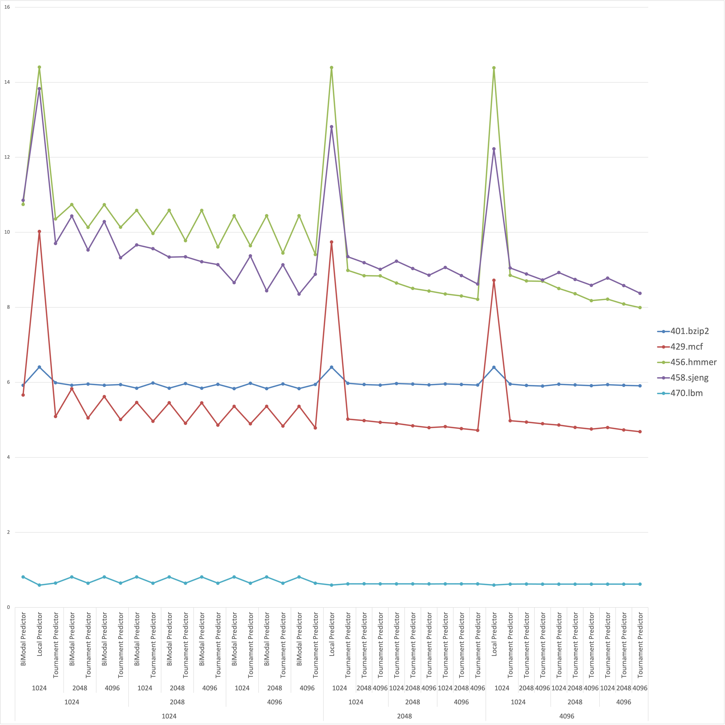
Average misprediction% for each benchmark
Based on the pattern here, we can clearly say that the behavior of the branch predictors is fairly consistent across all the benchmarks.

Slide 12
Code changes done at..(followed by a comment starting jxp220032)
/gem5/src/cpu/simple/baseSimpleCPU.py
/gem5/src/cpu/simple/base.cc
/gem5/src/cpu/pred/bpred_unit.cc
/gem5/src/cpu/simple/exec_context.hh
/gem5/src/cpu/pred/bpred_unit.hh
/gem5/src/cpu/pred/BranchPredictor.py:

Slide 13
Learnings..
Tournament branch predictors are usually more accurate for a given table size
BiModal is better than Local and performs almost on par with Tournament branch predictor and is better choice for smaller cores. (for embedded processors)
Increasing table sizes account for better accuracy across all 3 predictors.
GEM5 is good tool for academic learning but it is not practical for testing a completely new design innovations in CPU micro architecture.
If we have more hardware resources , it is possible to run simulations for large set of parameters simultaneously by python subprocess library. We observed that CPU cores are only 35% loaded while running a GEM5 simulations. So we started executing 8 simulations at once using concurrent.futures module consuming 30% CPU resources per thread. This helped us execute all 195 the simulations in a day. We would be happy to use this methodology for future use cases.
We put a check to verify if the simulation is already executed but looking at stats files. This helped us to track the remaining simulations better in an automated way.

Slide 14
Challenges faced
Building GEM5.opt on RISC(M1,M2..) based Mac isn’t successful. Finally opted to go with UTD servers. The provided Project PDF doc is not up to date. On windows it works well with WSL2. (Not WSL1)
Benchmarks pulled from the provided git repository <https://github.com/timberjack/Project1_SPEC> contains a binary under each <benchmark>/src directory.
To verify the correctness and compatibility of c++ binary , We recompiled. Static compilation of c programs on server is impossible if it uses libm.a / libc.a and most of the benchmarks use it.
This forced us to verify with dynamic compilation. Once we overwritten the binary, it worked from the terminal (./benchmark <input args>) but GEM5 doesn’t support dynamically linked binaries. Trying to install libm.a / libc.a on UTD servers almost consumed a day without any progress as we do not have SUDO permissions. Hence, we had to again clone the repo and assume the binaries are compatible. We discovered this late.
The GEM5 version on server uses older python version and the code is not up to date with GEM5 git repo. This caused some confusion on what python versions we should use for scripting.
Server CPUs are significantly slower than most personal computing machines owned by students. Git is the only reliable way to upload and download files from server. Verifying the stats.txt online has been challenge also editing the code using VI editor.
Disconnecting the SSH terminal window kills the remote server process. Only way to keep it running is by ctrl + z >> bg >> disown % <job id> . Once if we do this, job keeps running and there is no easy way to kill it after this. So disconnecting the job from terminal session needs to be done with careful thought.

